Slide 1
Group Members (GROUP NO. 23)--
Soumyadeep Basu - IIT2018001
Kumar Utkarsh - IIT2018007
Rohit Haolader - IIT2018008
Raushan Raj - IIT2018031
Suryasen Singh - IIT2018069
SECURITY ISSUES IN COGNITIVE RADIO NETWORKS

Slide 2
SECURITY ISSUES IN COGNITIVE RADIO NETWORKS
Cognitive Radio (CR) is a novel technology that promises to solve the spectrum shortage problem by allowing secondary users to coexist with primary users without causing interference to their communication.
The operational aspects of CR are being explored vigorously, its security aspects have gained little attention.
We categorize the attacks with respect to the layer they target starting from the physical layer and moving up to the transport layer.

Slide 3
INTRODUCTION
The technology developed to take advantage of the unused spectrum is Cognitive Radio Networks (CRNs) which are intelligent networks that adapt to changes in their environments to make a better use of the radio spectrum.
CRNs help solve the problem of spectrum shortage by allowing unlicensed users to use primary systems without interference.
This technology allows the coexistence and sharing of licensed spectrum resources between two types of users, licensed and unlicensed.
Cognitive Radio (CR) nodes have unique capabilities which allow them to take advantage of available white spaces in a spectrum.

Slide 4
Brief Overview of Cognitive Radio Technology
The device can then decide to make calls and communicate with other CR devices using these holes. There are two types of CRs : Policy Radios and Learning Radios.
Policy radios have some predefined policies that determine the behavior of a radio.
When a radio gathers information from the surrounding environment, the information is then turned into statistics that determines the radio’s state.
Learning radios have an extra component which is a learning engine, this engine allows them to configure and reconfigure their states.

Slide 5
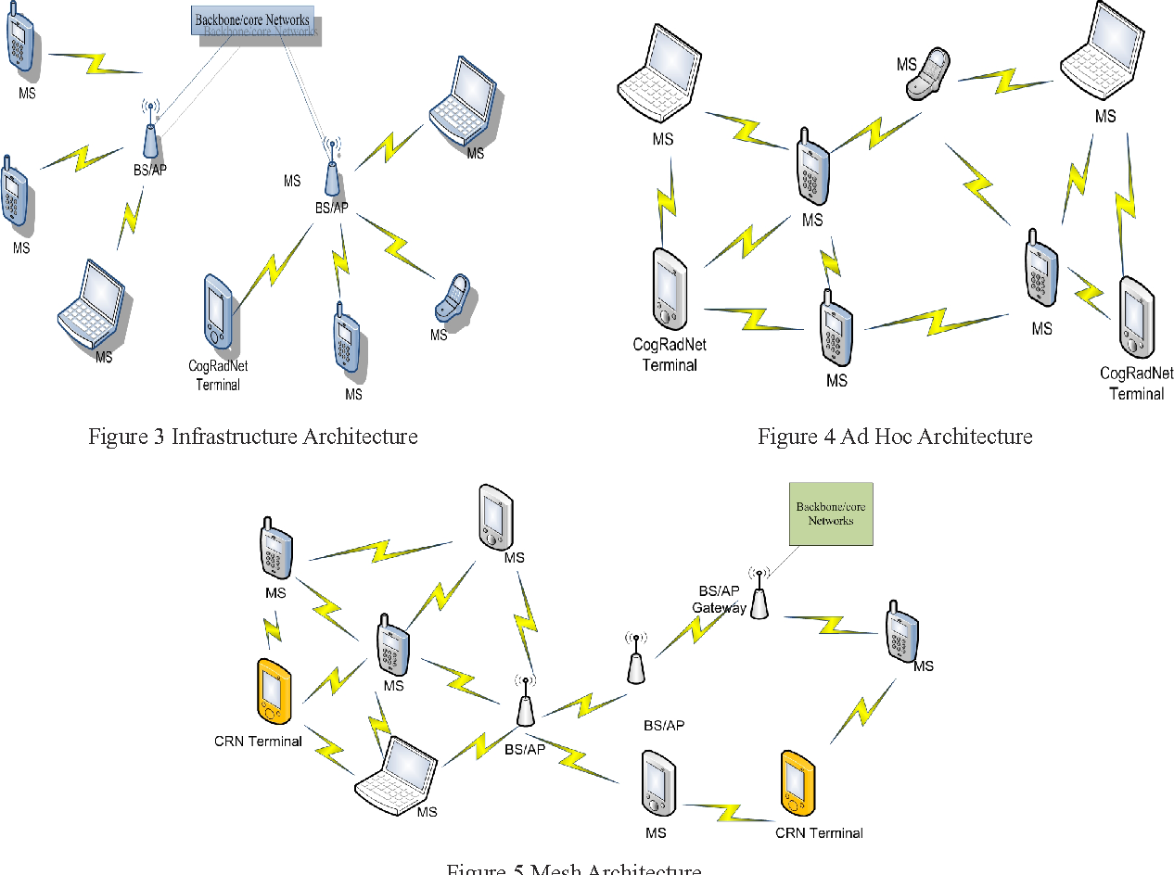
Cognitive Radio Technology

Slide 6
Spectrum Sensing
One of the primary requirements of cognitive networks is their ability to scan the spectral band and identify vacant channels available for opportunistic transmission.
As the primary user network is physically separate from the secondary user network, the secondary users do not get any direct feedback from primary users regarding their transmission.
The secondary users have to depend on their own individual or cooperative sensing ability to detect primary user transmissions.
The secondary users have to rely on weak primary transmission signals to estimate their presence. Most of the research on spectrum-sensing techniques falls into three categories: transmitter detection, cooperative detection and interference-based detection.
The main aim of all these techniques is to avoid interference to primary transmissions.

Slide 7
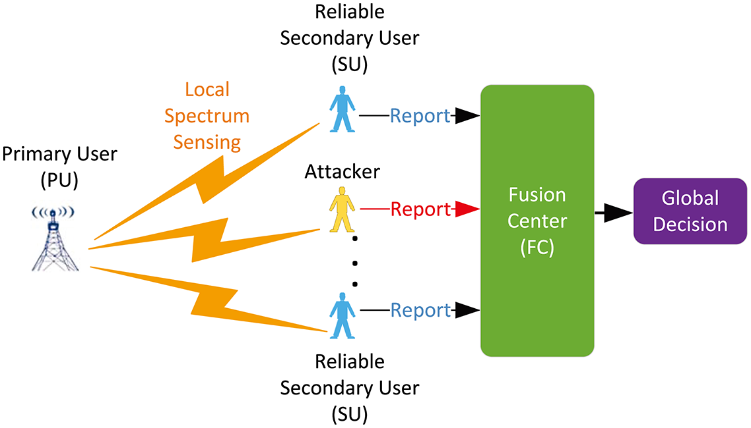
Spectrum Sensing

Slide 8
Spectrum Analysis and Decision
Each spectrum band has some unique features owing to its frequency range and the number of users (both primary and secondary) using the band.
Spectrum sensing determines a list of spectrum bands that are available; however, the secondary users decide on the most appropriate band from the list of available bands.
In addition to the commonly used SNR parameter, some of the characteristics of spectrum bands that can be used to evaluate their effectiveness are interference, path loss, wireless link errors, link layer delay and holding time

Slide 9
Spectrum Mobility
Spectrum mobility refers to the agility of cognitive radio networks to dynamically switch between spectrum access.
As secondary users are not guaranteed continuous spectrum access in any of the licensed bands and the availability of vacant spectrum bands frequently changes over time, spectrum mobility becomes an important factor when designing cognitive protocols.
One of the primary factors affecting spectrum mobility is the delay incurred during spectrum handoff.
This delay adversely affects protocols employed at various layers of the communication protocol stack.
Another important factor to be considered in spectrum mobility is the time difference between the secondary network detecting a primary transmission and the secondary users vacating the spectral band.

Slide 10
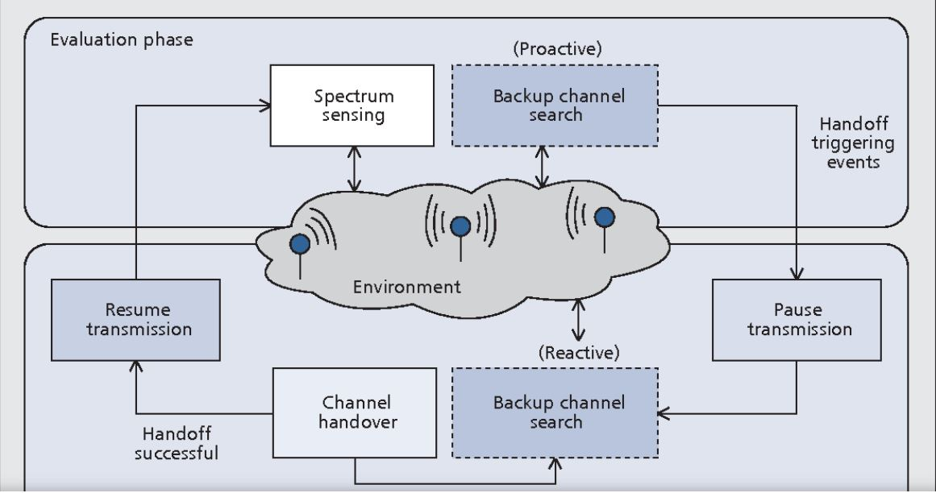
Spectrum Mobility

Slide 11
Threats and Attacks in Cognitive Radio Network
Threat is a constant danger through persons, objects, or any resources where as an attack is an act of or event that exploits the vulnerability.
The policies, learning mechanisms, and self-propagation in cognitive radio architecture prevents the threats (cannot escape the threats).
In CR, a threat can happen while sensing of information (due to involvement of a malicious user).
This information will then feed for learning and decision making.
The results produced will lead to inappropriate decisions (unacceptable decisions) due to a malicious user injected the faults.

Slide 12
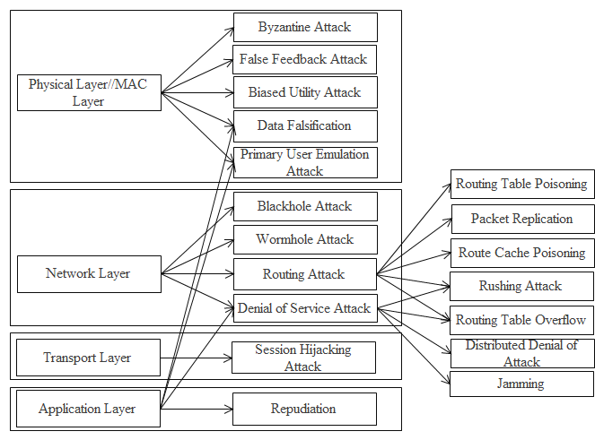
Attacks in Cognitive Radio Network

Slide 13
Physical Layer Attacks
In MISO, a multi-antenna SU transmitter sends confidential information to a legitimate SU receiver in the presence of an eavesdropper and on the licensed band of a primary user (PU).
The approach defines the Secrecy Capacity as the maximum achievable rate at which the data can be reliably sent from the SU transmitter to the legitimate SU receiver but is kept perfectly secret from Eavesdropper.
The secrecy capacity of a secure MISO CR channel has been characterized.

Slide 14
Primary User Emulation (PUE)
One of the Cognitive Radio principles is that a secondary user is allowed to use a specific band as long as it’s not occupied by a primary user.
If the secondary user detects another secondary user using the same band, certain mechanisms should be used to share the spectrum fairly.
Primary User Emulation (PUE) attack is carried out by a malicious secondary user emulating a primary user or masquerading as a primary user to obtain the resources of a given channel without having to share them with other secondary users .
As a result, the attacker is able to obtain full bands of a spectrum. The motivation behind the attack is divided into two categories: Selfish PUE attack and Malicious PUE attack.

Slide 15
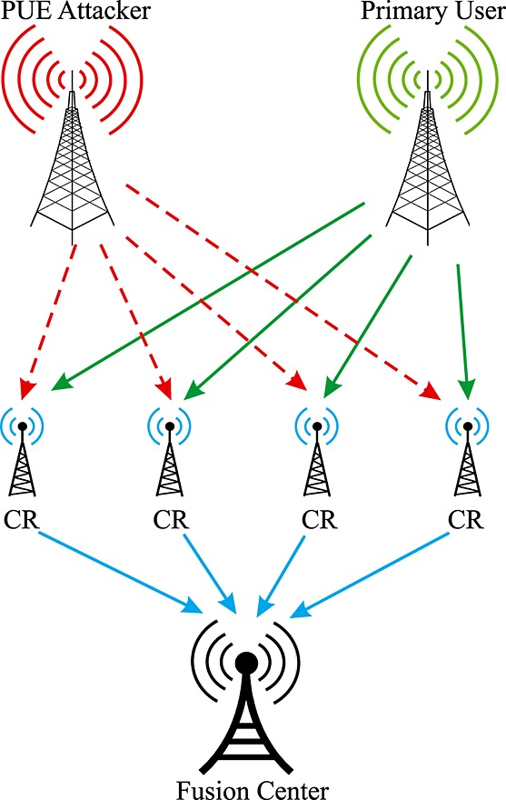
Primary User Emulation Attack

Slide 16
Defending Against Primary User Emulation Attack
To defend against PUE attacks, the identity of the transmitting source needs to be identified, i.e., is the transmitting source a primary user or a malicious user.
The usual and best approach of knowing the user identity is to apply cryptographic authentication mechanisms, such as digital signatures.
Given this restriction and knowing that primary users’ locations are known ahead of time, researchers resorted to finding efficient ways of pinpointing the location of the transmitting source.
If the location of the source matches the location of a primary user, the source is considered to be a primary user.

Slide 17
Objective Function Attack
The cognitive engine in the adaptive radio is the one responsible for adjusting the radio parameters in order to meet specific requirements such as low energy consumption, high data rate, and high security.
Radio parameters include center frequency, bandwidth, power, modulation type, coding rate, channel access protocol, encryption type, and frame size.
The cognitive engine calculates these parameters by solving one or more objective functions, for instance find the radio parameters that maximize data rate and minimize power.
When the cognitive engine is running to find the radio parameters appropriate to the current environment, the attacker can launch his attack by manipulating the parameters he has control on (transmission rate) in order to make the results biased and tailored to his interest.

Slide 18
Jamming
In jamming, the attacker (jammer) maliciously sends out packets to hinder legitimate participants in a communication session from sending or receiving data; consequently, creating a denial of service situation.
The jammer may send continuous packets of data making a legitimate user to never sense a channel as idle, or he can send these packets to the legitimate users and force them to receive junk packets.
The jammer can also disrupt communication by blasting a radio transmission resulting in the corruption of packets received by legitimate users.
A more dangerous attack a jammer can do is to jam the dedicated channel that is used to exchange sensing information between CRs .
An attacker can still do damage if he just eavesdropped on the control data and knew the new channel the CRN is switching to. He can then jam it.

Slide 19
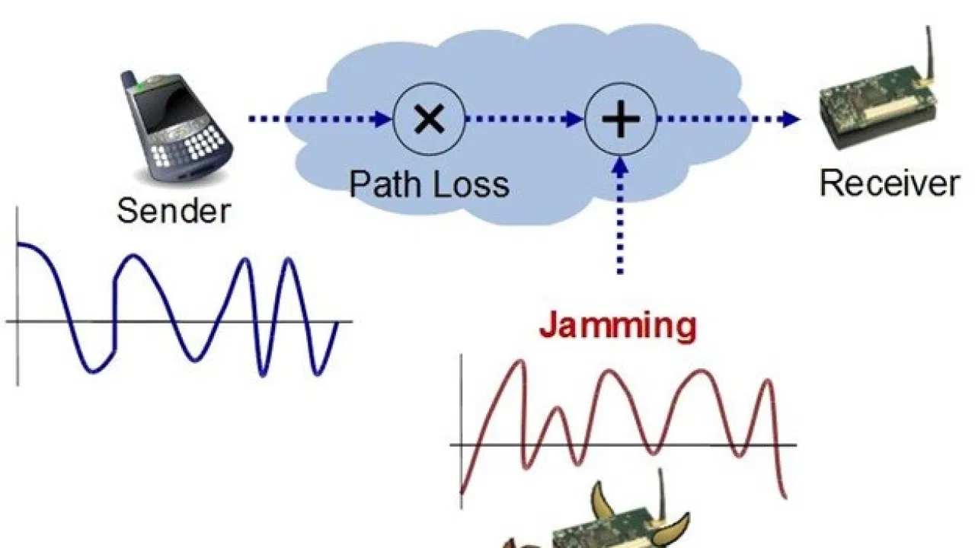
Jamming

Slide 20
Defending against Jamming
Since DoS can be performed at the Link and Physical layers, the detection should be addressed at both layers.
In the MAC-layer detection, devices can detect a denial of service attack by sensing the channel they want to transmit their packets on.
A popular class for medium access control protocols is the one based on carrier-sensing multiple access (CSMA). In CSMA, a device will continually sense a channel until it detects that it’s idle.
Even then, it will wait for some time before starting transmitting (propagation delay) in order to make sure that the channel is clear.
Suppose an attacker is sending packets on the same channel that the legitimate device wants to use for transmission, the legitimate device will never pass the carrier-sensing and will be forced to back off.

Slide 21
Sinkhole Attacks
Sinkhole Attacks In a sinkhole attack, an attacker advertises itself as the best route to a specific destination, luring neighboring nodes to use it to forward their packets.
An attacker may use this way to perform another attack called selective forwarding where an attacker is able to modify or discard packets from any node in the network.
The attack is particularly effective in the infrastructure and mesh architectures as all traffic goes through a base station allowing the attacker to falsely claim that it is the best route for packet forwarding.

Slide 22
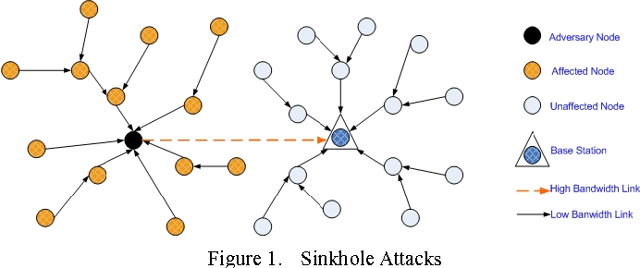
Sinkhole Attacks

Slide 23
Defending against Sinkhole Attacks
A sinkhole attack is hard to detect because it exploits the very design of the routing protocol and network architecture.
However, there are protocols that are fortified against the attack which are geographic routing protocols.
Geographic routing protocols construct a topology on demand using only local communications and information without initiation from the base station.
Thus, traffic will be routed to the physical location of the base station and will be difficult to lure it to go elsewhere to create a sinkhole.

Slide 24
Challenges and defending malicious attacks
Ensuring trustworthy spectrum sensing is one of the essential mechanisms in CRs.
The primary signal analysis is suggested in the current survey. Trust on spectrum sensing happens if the primary signal is emulated and recognized correctly.
For example, a malicious user or hacker can interpret the primary user signal and occupy the spectrum for selfish use.
The attack can be detected through transmitter verification procedures and location verification procedures. Further, a cognitive user simulates the primary user for personal gains. That means, a cognitive user crosses its user access limits.
These activities can be controlled using the various privacy procedures and access limits. This problem can be fixed using a honey pot database to mislead the malicious user.

Slide 25
Conclusion
The main motivation behind cognitive radios is to increase spectrum utilization by allowing the unlicensed users to opportunistically access the frequency band actually owned by the licensed user.
The categorization gives rise to several security issues that are unique to cognitive radio communications.
Security aspects such as authentication and authorization of users, confidentiality and integrity of communication as well as identification and nonrepudiation of cognitive user devices have also been discussed.
Several novel security attacks on different layers of the protocol stack in cognitive networks that make use of one or more of the inherent vulnerabilities.
Through these attacks we showed that the fundamental idea behind cognitive networks is not yet fulfilled.

Slide 26
THANK YOU!!

